Slide 2
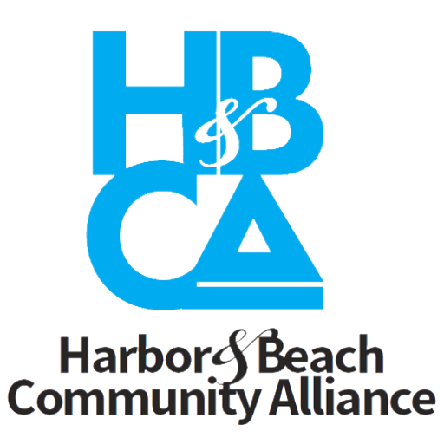
Karls Strawberry Village
PROS
Karls’ “Strawberry Village” will be a place of fun activities for families to bring their children and grandkids. The harbor has no wholesome fun place for kids and neither does Ventura Harbor. There are events but no place within Ventura County for families to repeatedly visit and enjoy with their kids for a few hours.
Karls will be an affordable place to visit as it is free to all with open public access to the waterfront and best views.
It will be a unique destination that would differentiate the harbor and be a promotional visitor and tourist driver.
Karls initially said the project would include some residential for some of its employees but to avoid the Public Works Plan (PWP) and Local Coastal Plan (LCP) Amendments Processes and HCI re-zoning Requirements have said they will now not include any residential housing. This would mean the project could move forward without years of delay.
The restaurants, shops, live exhibits, and boutique hotel will be owned and operated by Karls. Karls’ success does not depend on finding appropriate lessees nor on others’ operating abilities.
Other Pros to Note:
The “strawberry” theme will heighten and invigorate the promotional impact of Oxnard as the strawberry capital of the USA which will benefit local strawberry growers and open a new market for their product.
As its first and flagship location in the USA, Fisherman’s Wharf is an important project for the company and would receive commensurate attention and effort from the company.
The developer has a performance track record and financial capability to deliver on the proposal.
Karls propose an exchange training program for employees to go to Germany and for their German employees to come to the USA to exchange knowledge.
If the lease is not renewed at a future date, then repurposing the area would be more viable than the other proposals.

Slide 3
Karls Strawberry Village
CONS
The strawberry theme should integrate some nautical theme and concepts into their design plan – for example only, Strawberry Village by-the-Sea, Strawberry Village on the Wharf, logo of strawberry with sea captain hat and cob pipe, etc
Since Karls is a German Company and this will be their first project in California and the USA, the company may not be familiar with the area’s building and safety code requirements and should retain a local company to work with them on design and building requirements, as well as an expert in Coastal development policies.

Slide 4
Mixed Use Development – Ashkar’s Pacific Heritage
PROS
CONS
The developer has extensive experience in the County and strong development and financial credentials.
The project includes a fresh fish market supplied by local fishermen and a Farmer’s market from local producers.
The project concept includes a boutique hotel and amphitheater as well as dining, entertainment and shopping facilities.
This proposed development must include residential for the “financial feasibility” of the project. This a familiar proposition to this community who said no to apartments for the past 5 years at this site. What is also very concerning is Pacific Heritage fails to say how many apartments their “endeavor” will require. This is unacceptable. The number of units should be known before any support or Exclusive Right To Negotiate (ERN) is considered for this project.
Because the proposal has residential as an essential element, the project will require Public Works Plan (PWP), Local Coastal Plan (LCP) and HCI Zoning Amendments. These processes, as has been seen, will take 5-7 years before any serious work and construction could start. This means Fisherman’s Wharf would continue to sit empty and a deteriorating eyesore and safety liability for at least another 5-7 years. It could take a decade before this project is completed and operating.
The big “benefits” of this project to the community (restaurant, entertainment, hospitality) are dependent upon an unknown “variety” of operators who will lease those facilities from the developer. Given the number of retail shops, bars and restaurants already at the harbor, north and south of the bridge, and those coming soon at the new Hyatt Place Hotel and the revitalized Whale’s Tail, the question is how many more restaurants, bars and shops can this area support, especially since many of the residences are second homes? How many restaurants and shops are successful now?
There are questions regarding the wide appeal this project would have as a destination and driver of visitors/tourists. There are also questions of the affordability of its proposed restaurants and shops to the communities outside of the harbor area and throughout Ventura County.
Its mixed use plan is a conventional combination of commercial and residential nothing different from other harbor/waterfront developments to differentiate Channel islands Harbor. It is interesting to note that this proposal is very closely similar to the one Pacific Heritage submitted to Ventura Harbor in late 2016 but without residential for feasibility purposes. This shows this plan could be at any harbor and would not differentiate Channel Islands Harbor from other harbors.

Slide 5
Specialty Lifestyle Market Anchored Retail Center – Vallner & Litwak
PROS
CONS
The initial phase of this project does not require PWP, LCP and HCI zoning Amendments as there is no residential.
Proposal shows generous public open spaces, an Amphitheater for events as well as restaurants and retail shops
This developer has the experience and track record in the development of similar projects
The anchor specialty market is essential to the viability of this proposal. There is no guarantee that the developer will attract a viable specialty market. Approving a project with an undetermined key element risks long delays and possibly the need to reissue a new RFP and start the proposal process over again – further delaying the revitalization of a deteriorated Fisherman’s Wharf. Adding to the risk of this project, is the concern that the mixed-use project on the vacant lot next to the Rite Aid near the intersection of Victoria/Channel Islands Boulevard, has been held up for several years as it has been unable to attract an appropriate specialty market needed for its approved project.
The proposal also includes the idea of a “future Opportunity” to expand their development using some of the parking lot space for additional commercial/retail facilities or residential should the community approve. This appears to be a hedge/back up plan should the initial plan fail to be viable as initially proposed. This is a plan with future proposed conditions that may not be acceptable even now. Once the initial phase of this project is built, this “future opportunity” puts the County and community in the difficult position of either rejecting expansion or finding other alternatives.
The proposed project is not a compelling destination and driver of visitors/tourists. Plan is not exciting, offers a conventional development concept. It is also questionable as an affordable attraction with County-wide appeal.

